Slide 1

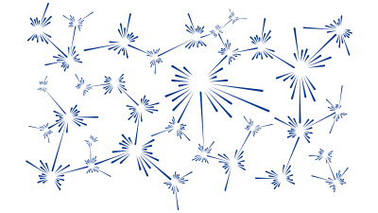
Introduction to Inelastic Neutron Scattering and handling powder INS data.
M. D. Le
India-RAL Neutron and Muon Science Meeting
Notes:
The abstract pattern can be removed or repositioned if required. Be careful to ‘Send to Back’ so that it does not obscure any important information.

Slide 2
Inelastic Neutron Scattering
Why?
Material properties depend on their structure
But, atoms are not stationary
Dynamics also important → inelastic neutron scattering can measure the dynamics of atom and spins.

Slide 3
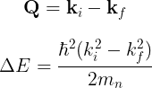
In elastic scattering, need to satisfy Bragg condition
Can be represented in an Ewald construction (sphere)
For inelastic scattering, |k_{i}| ≠ |k_{f}|
Ewald’s sphere
G
k_{f}
k_{i}
k_{i}
Q
k_{f}
G
k_{i}
k_{i}
Now, have Q = k_{i} – k_{f} which defines the scattering triangle.

Slide 4
Single Crystals
The scattering triangle can be mapped directly to the axes of a 3-axis spectrometer
(k_{i} and k_{f} determined by Bragg diffraction from crystals)
A6
A5
q₁
Q
k_{f}
k_{f}
A2
A4
A1
k_{i}
k_{i}
k_{i}
q₂
A3

Slide 5
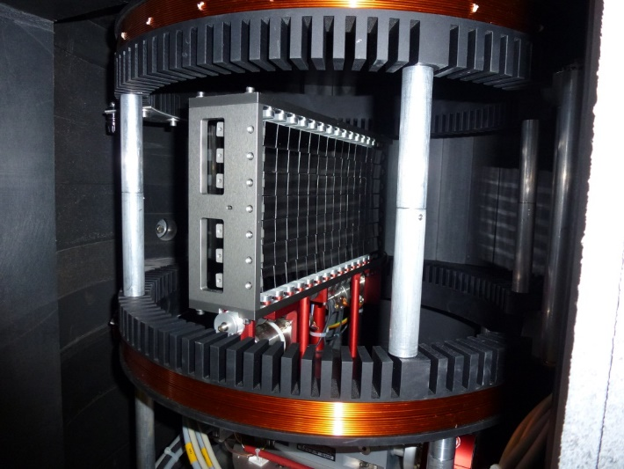
Single Crystals
The scattering triangle can be mapped directly to the axes of a 3-axis spectrometer
(k_{i} and k_{f} determined by Bragg diffraction from crystals)
A6
A5
k_{f}
q₁
Q
k_{f}
A2
A4
A1
k_{i}
k_{i}
k_{i}
A3
q₂
Rotating crystal effectively rotates the scattering triangle.

Slide 6
Powder samples
When we have a powder / polycrystalline sample, we have a random orientation of crystallites:
So the effectively we’re measuring an average over spherical shell of radius |Q|:
Q
k_{f}
k_{i}
k_{i}

Slide 7
Powder samples
When we have a powder / polycrystalline sample, we have a random orientation of crystallites:
So the effectively we’re measuring an average over spherical shell of radius |Q|:
Q
k_{f}
k_{i}
k_{i}

Slide 8
Powder samples
When we have a powder / polycrystalline sample, we have a random orientation of crystallites:
So the effectively we’re measuring an average over spherical shell of radius |Q|:
Q
k_{f}
k_{i}
k_{i}

Slide 9
Powder samples
When we have a powder / polycrystalline sample, we have a random orientation of crystallites:
So the effectively we’re measuring an average over spherical shell of radius |Q|:
Q
k_{f}
k_{i}
k_{i}

Slide 10
Triple Axis Spectrometers
Recap – for a TAS we can map the scattering triangle directly to the three axes of the spectrometer, where we control k_{i} (or k_{f}) by the scattering angles of the monochromator (analyser) crystals.
A6
A5
q₁
k_{f}
q₁
Q
k_{f}
A2
A4
A1
k_{i}
k_{i}
q₂
k_{i}
A3
q₂

Slide 11
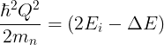

Time-of-flight Spectrometers
At time-of-flight sources, only need to define one of k_{i} or k_{f} , the other is determined by the detector position and neutron time-of-flight.
There are two types of ToF spectrometers:
“Direct geometry”: Fix k_{i}
Q
k_{f}
k_{f}
k_{i}
Direct geometry

Slide 12
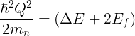
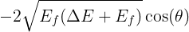
Time-of-flight Spectrometers
At time-of-flight sources, only need to define one of k_{i} or k_{f} , the other is determined by the detector position and neutron time-of-flight.
There are two types of ToF spectrometers:
“Direct geometry”: Fix k_{i}
“Indirect geometry”: Fix k_{f}
Q
k_{f}
k_{i}
k_{i}
Indirect geometry

Slide 13
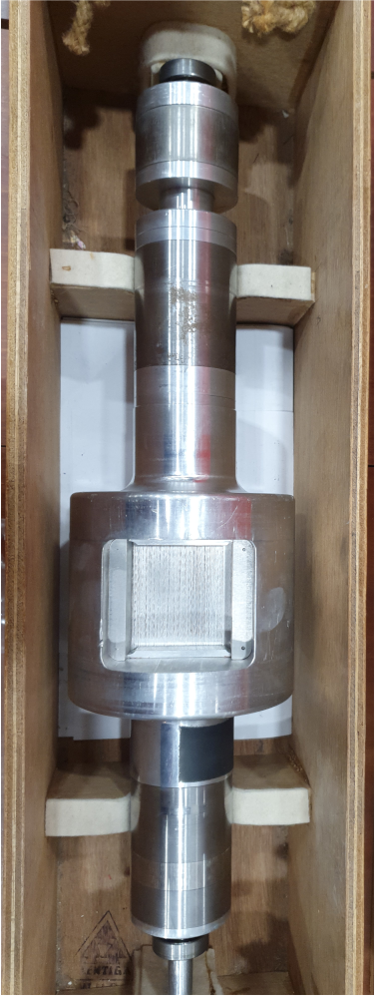
Direct geometry spectrometers usually use mechanical choppers to monochromate the incident k_{i}
Indirect geometry spectrometers usually use crystals to Bragg reflect a fixed final k_{f}

Slide 14
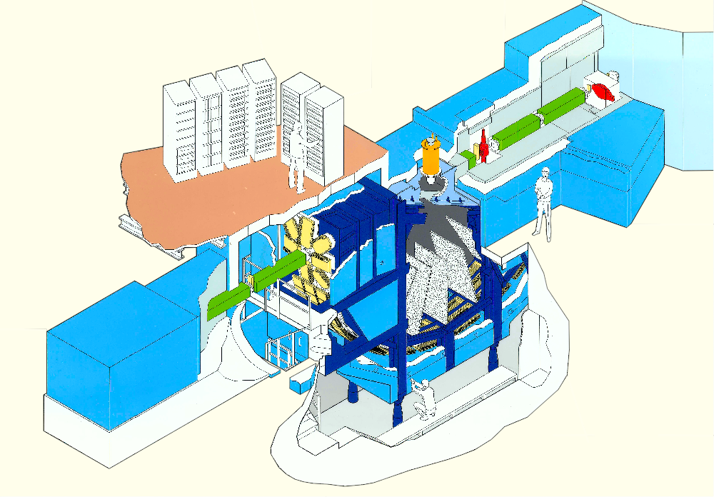
MARI
Direct Geometry Instruments
Spec
Ei = 7 meV to 1 eV
922 ³He tubes; 3° to 130°
ΔE/Ei = 2.5 - 5%

Slide 15
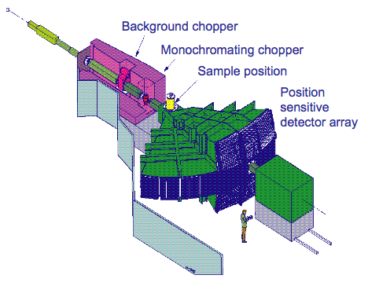
MAPS
Direct Geometry Instruments
Spec
Ei = 40 meV to 2 eV
40000 ³He PSD elements; 3° to 20° - main bank 20° to 60° - high angle bank
ΔE/Ei = 1 - 5%

Slide 16
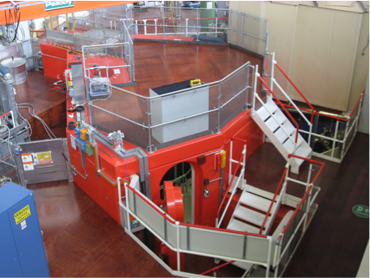
MERLIN
Direct Geometry Instruments
Spec
Ei = 10 meV to 2 eV
π steradians of ³He PSDs
(gapless)
x20 Maps flux
x7 Maps detector coverage
ΔE/Ei = 4 - 6%

Slide 17
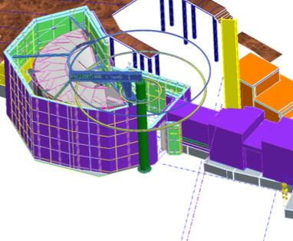
LET
Direct Geometry Instruments
Spec
Ei = 0.5 meV to 20 meV
π steradians of ³He PSDs
(gapless)
Same flux/coverage as Merlin
ΔE/Ei = 0.6 - 3.5%

Slide 18
Instrument suite
Direct Geometry Instruments
E_{i} (meV)
MAPS
MARI
MERLIN
(Flux)
LET
Q (Å)

Slide 19
Around the world
Direct Geometry Instruments
ISIS | LET | MAPS | MERLIN
ILL | IN5 | - | IN4
SNS | CNCS | SEQUOIA | ARCS
J-Parc | Amateras | HRC | 4Seasons

Slide 20
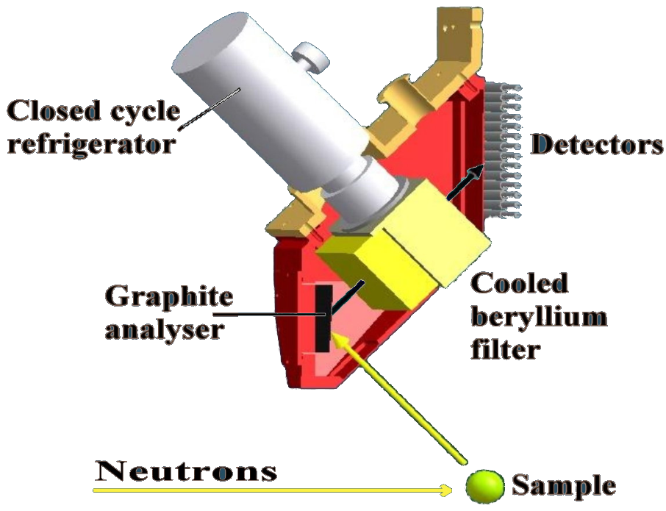
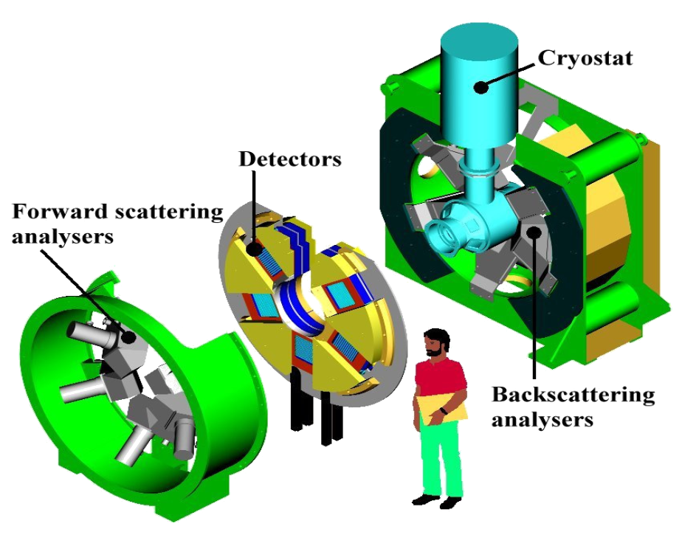
TOSCA
Indirect Geometry Instruments
Spec
Water moderator
E = 0~600 meV
ΔE/E = 1%
(energy transfer)
Detectors only around:
40-55° (forward)
125-140° (back)
n

Slide 21
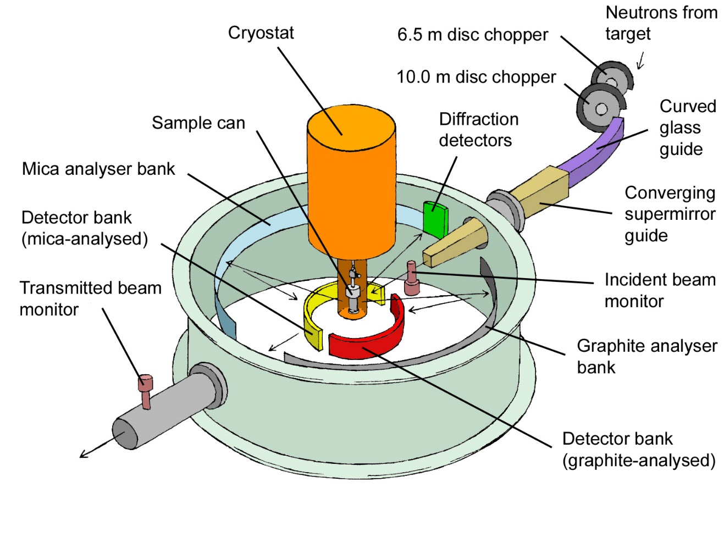
IRIS
Indirect Geometry Instruments
Spec
Hydrogen moderator
E < 4 meV
ΔE ~ 18µeV (PG)
High flux
Detectors 25<2θ<160°

Slide 22
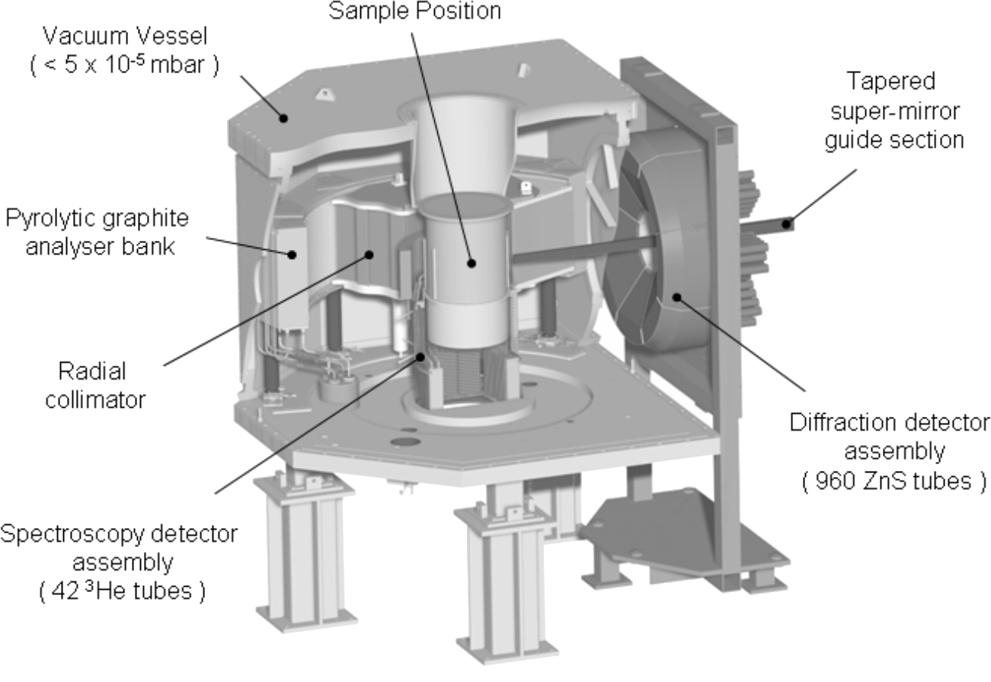
OSIRIS
Indirect Geometry Instruments
Spec
Hydrogen moderator
E < 4 meV
ΔE ~ 25µeV (PG)
Very high flux
Detectors 11<2θ<148°

Slide 23
Around the world
Direct Geometry Instruments
ISIS | TOSCA | IRIS/OSIRIS
SNS | VISION | BASIS
J-Parc |  | DNA

Slide 24
Questions so far?

Slide 25
Phonons
Phonons are quantised lattice vibrations
Can be treated as collective motions of particles (mass m) connected by springs with force constant C
Simplest case of a monatomic chain:
With solutions:
Giving a dispersion relation:

Slide 26
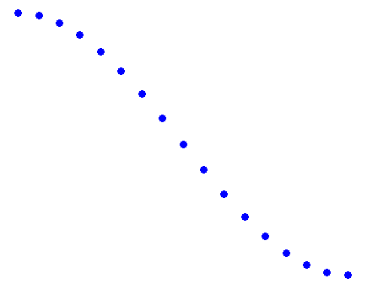
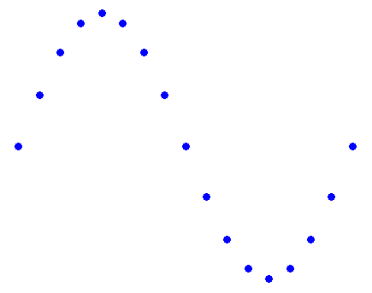
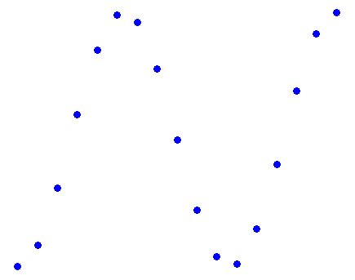
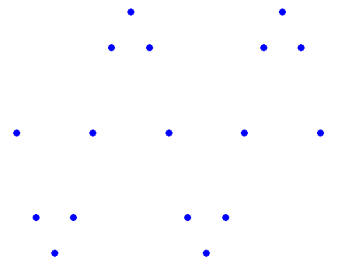
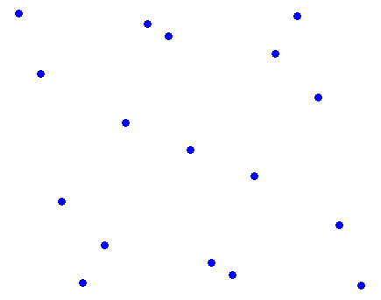

Phonons
Phonons
Transverse Acoustic Phonons
ħω
q (π/a)
0 0.2 0.4 0.6 0.8 1.0
Longitudinal
Phonons

Slide 27
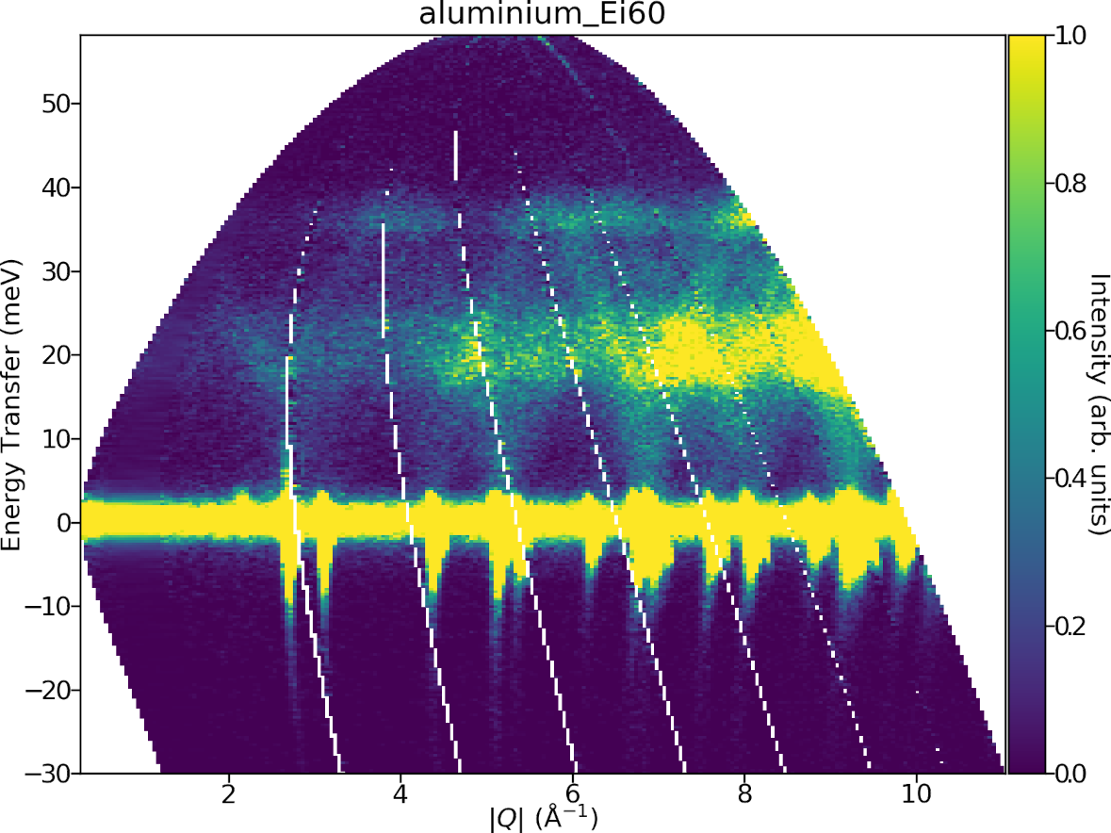
What does a INS phonon spectra look like?
See that there is much more intensity at high |Q| than low.

Slide 28
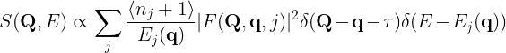
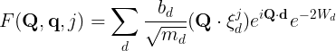
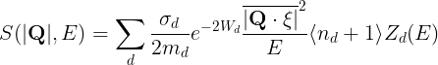
The dynamical structure factor for phonon scattering is:
In a powder or polycrystalline sample, we have to average over all the directions of the momentum transfer Q.
At large |Q|>>|q| for a given |Q| the angular average is also approximately an average over a Brillouin zone so the term disappears and the term can be replaced by the density of states Z(E), giving:
This is called the incoherent approximation.
Phonon dynamic structure factor
Polarization vector of mode d
Polarization factor
Debye Waller factor
Methods of experimental physics: Neutron scattering Pt A by Sköld and Price, Ch 1

Slide 29
Often though, the term is approximated as Q², which is only correct if we average over a full Brillouin zone
But the take home message here is the neutron intensity of phonon scattering increases with increasing Q.

Slide 30
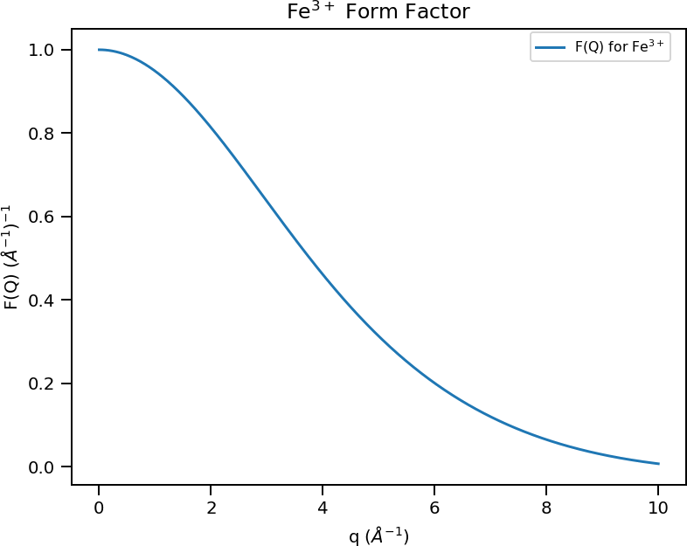
Magnetic scattering
Due to the magnetic dipolar interaction between the neutron moment and electronic spins.
Scattering function for magnetic neutron scattering is:
Magnetic form factor is highest at low Q:
M⊥ factor
Magnetic Form Factor
Because the electronic spins have a finite extent so their Fourier Transform is concentrated at low Q.
For phonons, scattering is due to the neutron-nucleus interaction, and nuclei are point particles compared to atoms
Magnetic excitations are most intense at low Q, opposite to phonon scattering.
Methods of experimental physics: Neutron scattering Pt A by Sköld and Price, Ch 1

Slide 31
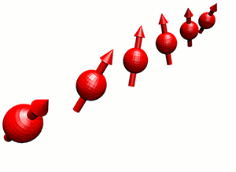
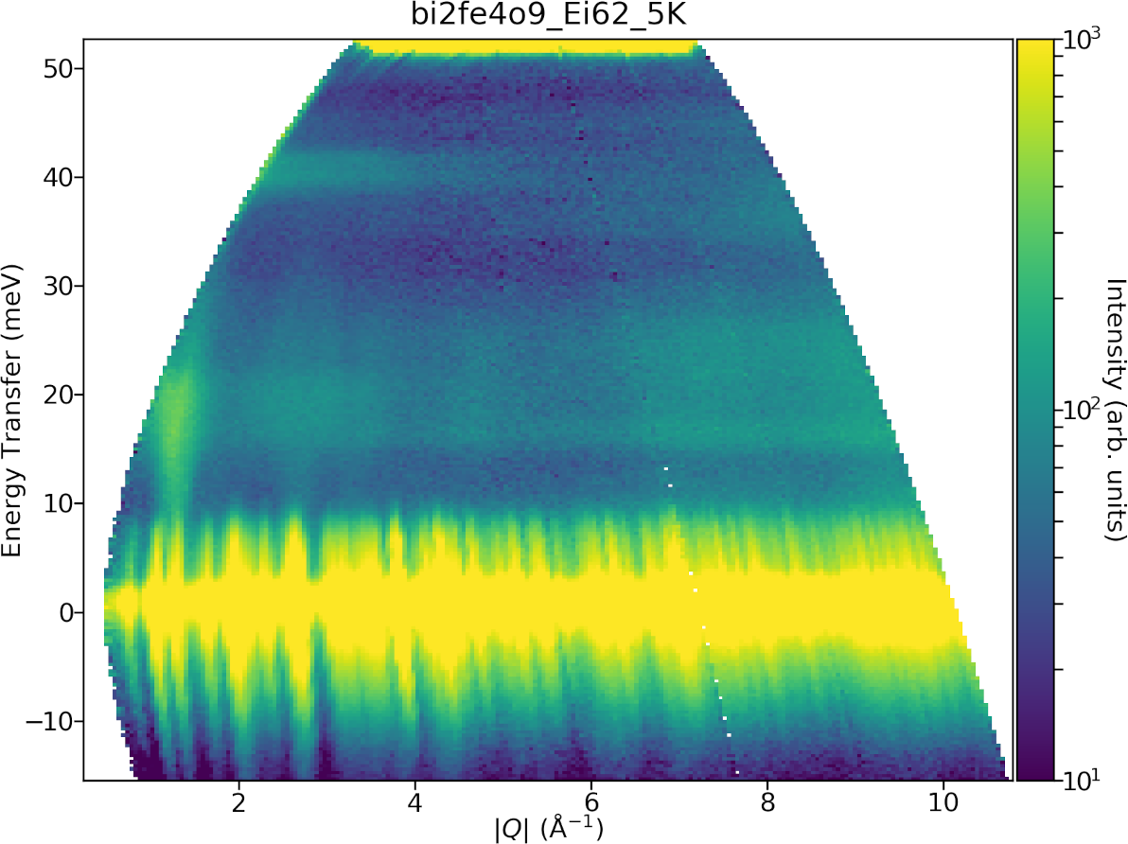
Spin Waves
Quantised collective precession of spins – small deviations from ordered magnetic state
Dispersive, can look like phonons
But, most intense at low Q.
Unlike X-rays, magnetic intensity for neutrons can be larger than lattice vibrations.
Can be modelled using linear spin wave theory with SpinW in later part of course.

Slide 32
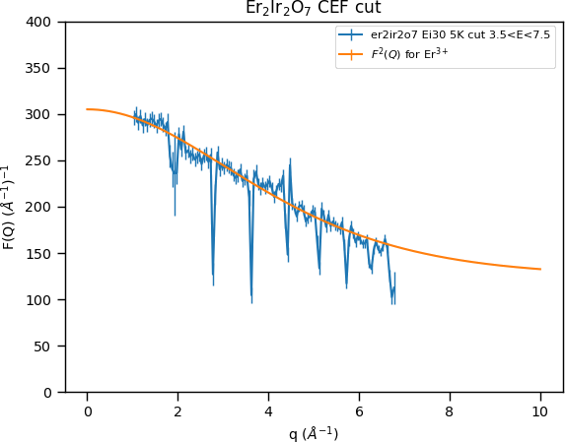
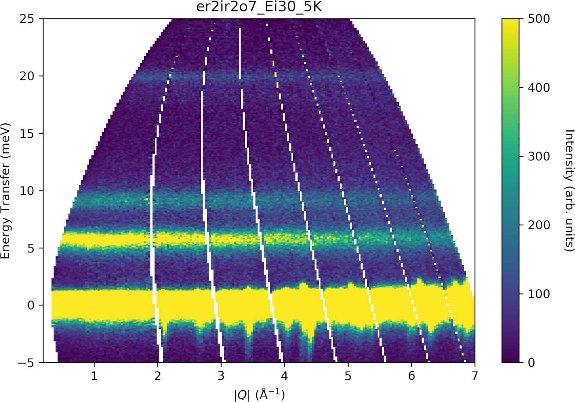
Crystal Field
Transitions between localised electronic states with different J_{z} or L_{z} quantum number excited on a particular magnetic ion excited by neutrons.
Dispersionless, but follow form factor.

Slide 33
Questions so far?

Slide 34
Summary / Take home
INS can be visualised using the scattering triangle.
In continuous sources (reactors), need to define both the incident and scattered neutron energy / wavevector (k_{i} and k_{f} ).
In time-of-flight INS, only need to define either k_{i} or k_{f} and use the ToF to infer the other.
ToF where k_{i} is fixed is direct geometry.
ToF where k_{f} is fixed is indirect geometry.
There are different kinematic trajectories for each case.

Slide 35
Summary / Take home
Phonons are quantised lattice vibrations (collective motions of atoms).
Phonon INS intensity is larger at high |Q| (approximately proportional to |Q|²).
Magnons are quantised spin precessions in an ordered magnetic state.
Crystal field excitations are excitations between localised electronic states with different with different J_{z} or L_{z} quantum number.
Magnetic excitations (magnons and crystal fields) follow the magnetic form factor and have highest INS intensity at low |Q|.

Slide 36
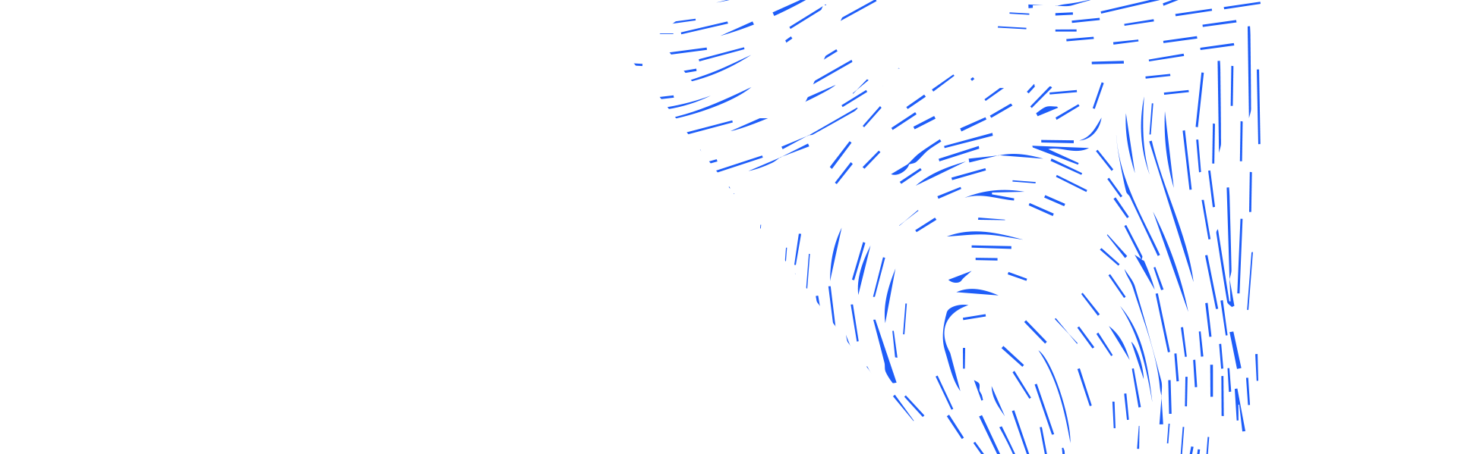



isis.stfc.ac.uk
@ISISNeutronMuon
STFC
Notes:
The abstract pattern can be removed or repositioned if required. Be careful to ‘Send to Back’ so that it does not obscure any important information.

